Slide 1
Chapter 3
Introduction to Optimization Modeling
Winston/Albright
Practical Management Science, 6e
© 2019 Cengage. May not be scanned, copied or duplicated, or posted to a publicly accessible website, in whole or in part.

Slide 2
Properties of linear models (1 of 4)
Linear programming is an important subset of a larger class of models called mathematical programming models.
All such models select the levels of various activities that can be performed, subject to a set of constraints, to maximize or minimize an objective such as total profit or total cost.
In terms of this general setup – selecting the optimal levels of activities – there are three important properties that LP models possess that distinguish them from general mathematical programming models:
proportionality,
additivity,
and divisibility.

Slide 3
Properties of linear models (2 of 4)
Proportionality means that if the level of any activity is multiplied by a constant factor, the contribution of this activity to the objective, or to any of the constraints in which the activity is involved, is multiplied by the same factor.
Proportionality is a perfectly valid assumption in the product mix model, but it is often violated in certain types of models.
For example, in various blending models used by petroleum companies, chemical outputs vary in a nonlinear manner as chemical inputs are varied.

Slide 4
Properties of linear models (3 of 4)
The additivity property implies that the sum of the contributions from the various activities to a particular constraint equals the total contribution to that constraint.
The additivity property implies that the contribution of any decision variable to the objective or to any constraint is independent of the levels of the other decision variables.

Slide 5
Properties of linear models (4 of 4)
The divisibility property simply means that both integer and noninteger levels of the activities are allowed.
In general, if you want the levels of some activities to be integer values, there are two possible approaches:
You can solve the LP model without integer constraints, and if the solution turns out to have fractional values, you can attempt to round them to integer values; or
You can explicitly constrain certain changing cells to contain integer values.

Slide 6
Discussion of Linear Properties
The previous discussion of these three properties, especially proportionality and additivity, is fairly abstract. How can you recognize whether a model satisfies proportionality and additivity? This is easy if the model is described algebraically. In this case the objective must be of the form a₁x₁ + a₂x₂ + · · · + a_{n}x_{n} where n is the number of decision variables, the a’s are constants, and the x’s are decision variables.
This expression is called a linear combination of the x’s. Also, each constraint must be equivalent to a form where the left side is a linear combination of the x’s and the right side is a constant. For example, the following is a typical linear constraint: 3x₁ + 7x₂ - 2x₃ = 50

Slide 7
Linear models and scaling
In some cases, the Solver message may indicate that the proportionality and additivity conditions are not satisfied. This could be:
due to a logical error in formulation, or
due to a roundoff error in Solver’s calculations.
In any case, it always helps to have a well-scaled model, where all of the numbers are roughly the same magnitude.
If the model is poorly scaled, you can:
check the Use Automatic Scaling option in solver,
redefine the units in which the various quantities are defined, or
change the Precision setting in Solver’s Options dialog box to a larger number.

Slide 8
Infeasibility and unboundedness (1 of 3)
Two things that can go wrong when the Solver is invoked, indicating a potential mistake in the model, are infeasibility and unboundedness.
Because mistakes are common in LP models, you should be aware of the error messages you might encounter.

Slide 9
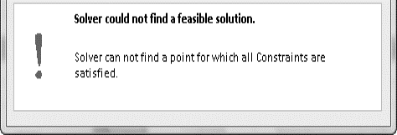
Infeasibility and unboundedness (2 of 3)
Infeasibility occurs when there are no feasible solutions to the model.
There are generally two reasons:
There is a mistake in the model (an input was entered incorrectly, such as a < symbol instead of a >), or
The problem has been so constrained that there are no solutions left.
A careful check of the model and finding an error, or changing/eliminating some of the constraints might fix the problem.
Resulting error message:

Slide 10
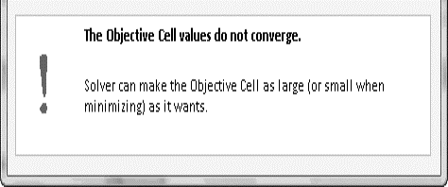
Infeasibility and unboundedness (3 of 3)
In case of unboundedness, the model has been formulated in such a way that the objective is unbounded – that is, it can be made as large (or as small, for minimization problem) as you like.
If this occurs, you have probably entered a wrong input or forgotten some constraints.
Resulting error message is shown here:

Slide 11
Comparison of infeasibility and unboundedness
Infeasibility and unboundedness are quite different in a practical sense.
It is quite possible for a reasonable model to have no feasible solutions. Together, they might constrain the problem so much that there are no feasible solutions left. The only way out is to change or eliminate some of the constraints.
An unboundedness problem is quite different.
There is no way a realistic model can have an unbounded solution. If you get this error message, then you must have made a mistake: You entered an input incorrectly, you omitted one or more constraints, or there is a logical error in your model.

Slide 12
End of Chapter 3

